Slide 1
Song Genre Prediction with Multinomial Naïve Bayes Classification
Spring 2021: CS 5002
Florence Gurney-Cattino
Jameson Albers
Zongrui Liu

Slide 2

Introduction – Personal Relevance
Music Backgrounds
Interest in NLP
Course Application to Music

Slide 3

Introduction – Project Question
Can a computational model predict the genre of a song by analyzing the lyrics?

Slide 4


Model Design
Two Genres: Country & Hip Hop
Data Classes: Genres
Data Features: Lyrics

Slide 5
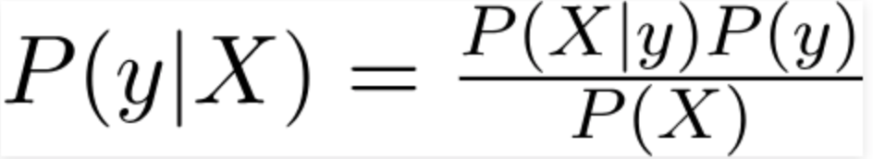
Model Theory and Concepts
Bayes’ Theorem
X: Features
y: Class

Slide 6
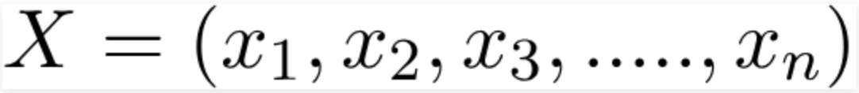
Model Theory and Concepts – Cont.
Multinomial Naïve Bayes Model

Slide 7
Model Theory and Concepts – Cont.
Multinomial Naïve Bayes Model (Cont.)

Slide 8
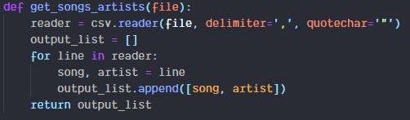
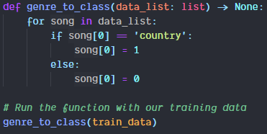
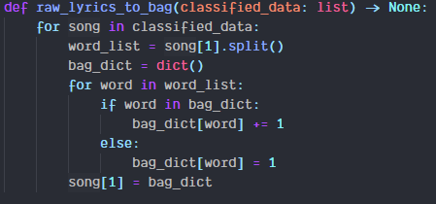
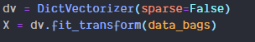
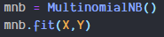
Programming Model
Read Raw Data
Get Classes and Features (Bag of Words)
Vectorize Classes and Features
Train!
Notes:
Core Course - mandatory

Slide 9
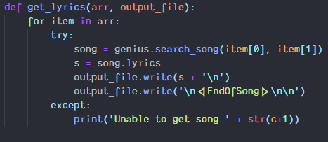
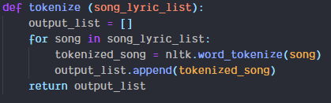
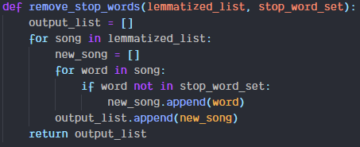
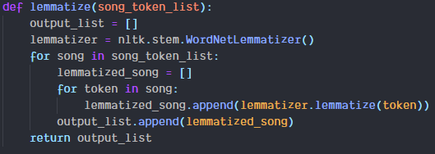
Test Data Preparation & Prediction
Scrape Lyrics
Tokenize & Lemmatize
Vectorize
Predict!
Notes:
Core Course - mandatory

Slide 10
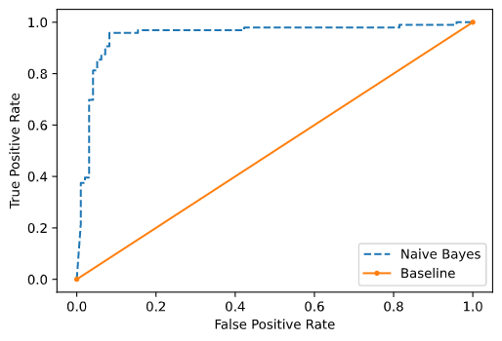
Results – Statistics
Receiver Operating Characteristic (ROC) Curve
Accuracy: 90.67%
AUC Score: 0.948
Notes:
Not a core or mandated course but highly recommended.
Prerequisite is the Project Course
Usually taken in your final semester in the program and is presented to an audience of your peers and your faculty upon completion of the Thesis
Highly recommended for anyone who is thinking about conducting research in the future, earning a PhD (eventually), or if you’d like to go deeper into a topic area

Slide 11
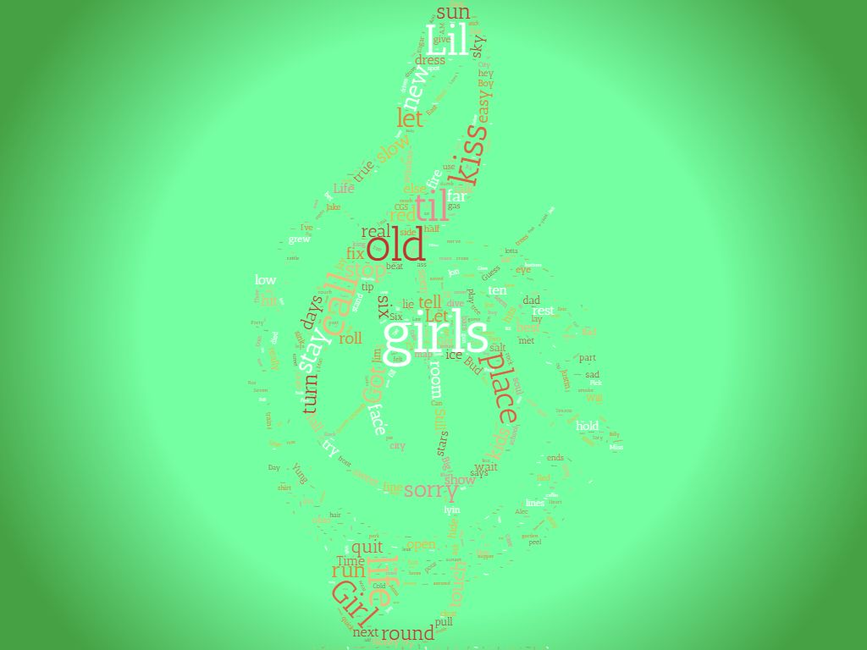
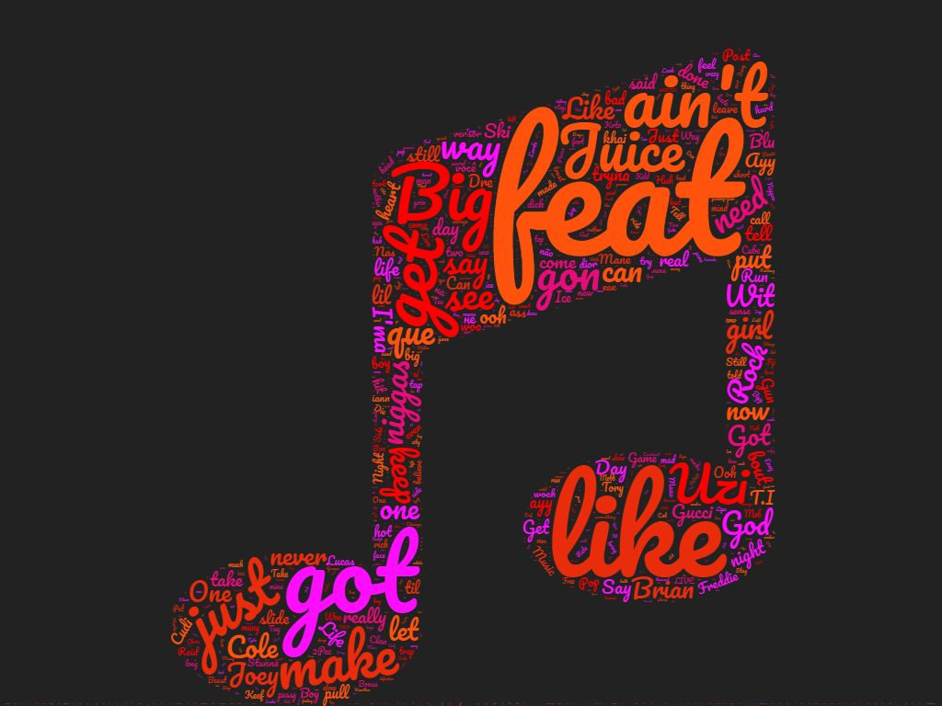
Results – Linguistic Insights
Notes:
Not a core or mandated course but highly recommended.
Prerequisite is the Project Course
Usually taken in your final semester in the program and is presented to an audience of your peers and your faculty upon completion of the Thesis
Highly recommended for anyone who is thinking about conducting research in the future, earning a PhD (eventually), or if you’d like to go deeper into a topic area

Slide 12

Limitations/Future Research
Bag of Words Model
Data Limitations
Neural Networks
Combining Features
Notes:
Not a core or mandated course but highly recommended.
Prerequisite is the Project Course
Usually taken in your final semester in the program and is presented to an audience of your peers and your faculty upon completion of the Thesis
Highly recommended for anyone who is thinking about conducting research in the future, earning a PhD (eventually), or if you’d like to go deeper into a topic area

Slide 13
Questions?
https://github.com/jlalbers/discrete

